Slide 1

School’s Infrastructure Analysis
Prepared by
Linxsly ALEXIS

Slide 2

Table of contents
Introduction
Exploratory & Analysis
Recommendations
Problems to solve
Visualization
Propose Solution
Goal of the project
Machine Learning
Presentation
Public cible
Thank you
Data Source
Methodology

Slide 3

Introduction

Slide 4

Story Telling
You live with a family? You have children? Brothers? Sisters?
You have to move on with your family from a department to another one? What about your children’s career? Which school would you choose for them?
So many unanswered questions... Perhaps due to a lack of information about the infrastructure of the schools or a lack of knowledge about their performance...
What will you prioritize? Infrastructure or results? Or maybe both?
4

Slide 5

Problems to be solved
We would like to rank the schools according to their vulnerability in relation to their infrastructure and their level of performance...
5

Slide 6


Firstly, we will create a score to classify the schools into three classes. After that we will classify the schools into different clusters while defining the characteristics of each cluster. And create a dashboard allowing users to better visualize the different profiles. That is to say, a family that moves to a department that is in this list, it will know which commune has the best schools according to the parameters of the cluster.
6

Slide 7


Target audience
First of all, we intend to help families who migrate and feel concerned about their children's education. They will be the first to benefit the results of this research.
There is also the government (MENFP) which can also use these results to give grants, depending on the vulnerability of the schools. Assuming that there is some relationships between infrastructure and student outcomes, the state could provide grants and subsidies to the lowest performing schools.
.
7

Slide 8



Data Source
The data we used comes from the MENFP database, via Ayiti Analytics. And they include the number of schools per municipality, infrastructure, student results, school information.
Source
690K
Ayiti Analytics dataset
8

Slide 9



Methodology
Cleaning data
it’s the most hard part , we remove and replace null values and the wrong values.
Collect data
We receive data from DHS P rogram
We complete the dataset with the data from Ayiti Analytics data
We use Open Street Map API to ﬁnd geolocate
Analysis
We analyze the data
We perform a Machine Learning (K_means Clustering)

Slide 10


Exploratory Analysis
10

Slide 11
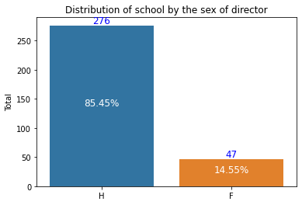
As we can see only 14% of the directors of the dataset are women, compared with 82% of men. The 3% left is undefined. Maybe it's a problem with the survey or the investigators. Or these schools don't have an organizational structure.

Slide 12
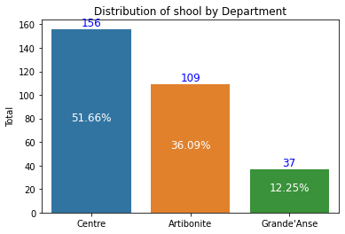
According to our dataset, we can notice that more than 50% of the schools are located in the department Centre. And less than 13% in Grand'Anse. Does that mean the level of education is related to the number of schools?

Slide 13
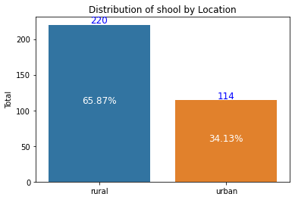
As we can see, more than 65% of the schools are located in rural zones. The other 34% are in urban zones. Can we say that there are more rural zones in those 3 departments?.

Slide 14

We will perform a k-mean clustering which consists in grouping the data in several groups of commune in our case according to the similarities of their schools’ infrastructure or results after having determined the optimal number of group or cluster = k.
KMeans Clustering

Slide 15
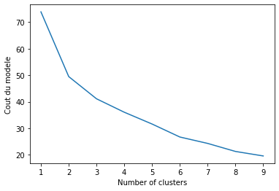
A fundamental step for any unsupervised algorithm is to determine the optimal number of clusters into which the data may be clustered. The Elbow Method is one of the most popular methods to determine this optimal value of k. In our model, we have 3-Means.

Slide 16
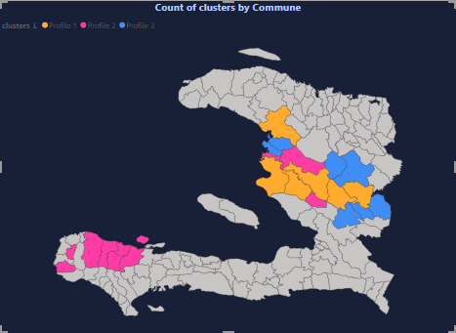
This is a map of distribution of the clusters by commune for the three department that I had to work on. (Centre, Artibonite, Grande’Anse)

Slide 17
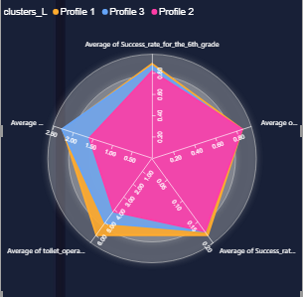
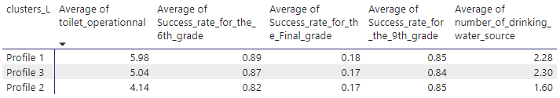
This is a description of the three clusters, we can notice that there’s a small difference of the success rate in the three clusters, and for the infrastructure too… We can notice the profile the most vulnerable is the second one. They have less infrastructures than any others.
Description of the clusters

Slide 18
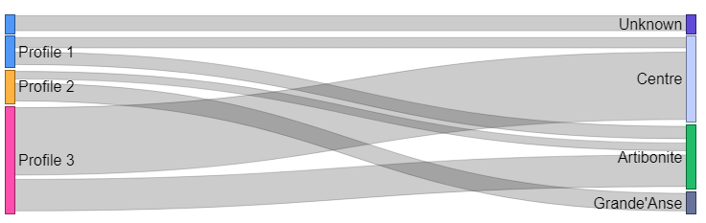
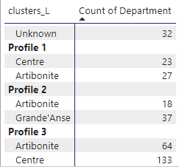
This graph shows the number of clusters by department. The second profile, which is the worst, is the only one profile to have school in Grande’Anse. That means, in this department, there are not only an infrastructure’s problem but also an educational problem.

Slide 19

We’ve made a dependence test between the infrastructure and the success rate. We’ve found that they are not dependent. Correlation is not causation, we already know that the success rate is correlated with the infrastructure of the schools based on some studies conducted by international organizations such as World Bank... Because of this we will suggest the government to give more grant programs in this municipalities.
Recommendations

Slide 20
According to the data and analysis, we will suggest the family to use our dashboard, more precisely the radar chart to see clearly the municipalities with the best performance and the best infrastructures. If they need to introduce some others factors
Recommendations

Slide 21




THANK YOU
Linxsly ALEXIS
+509 46976429
alexislinxsly@gmail.com

Slide 22
QUESTIONS?

